Slide 1
Object Detection And Tracking
By
Santhana selvam chandru (210819205045)
Suresh raja perumal (210819205058

Slide 2
Abstract
Real time object detection is a vast, vibrant and complex area of computer vision.
if there is a single object to be detected in an image, it is known as Image Localization and if there are multiple objects in an image, then it is Object Detection.
The applications of real time object detection include tracking objects, video surveillance, pedestrian detection, people counting, self-driving cars, face detection, ball tracking in sports and many more..

Slide 3
Introduction
Object Detection is the process of finding and recognizing real-world object instances such as car, bike, TV, flowers, and humans out of an images or videos. An object detection technique lets you understand the details of an image or a video as it allows for the recognition, localization, and detection of multiple objects within an image.

Slide 4
Modules
OpenCV
  OpenCV stands for Open supply pc Vision Library is associate open supply pc vision and machine learning software system library.
  The purpose of creation of OpenCV was to produce a standard infrastructure for computer vision applications
  It is a rich wholesome libraby as it contains 2500 optimized algorithms, which also includes a comprehensive set of both classic and progressive computer vision and machine learning algorithms

Slide 5
Numpy
  A numpy array is a grid of values, all of the same type, and is indexed by a tuple of nonnegative integers.
  The number of dimensions is the rank of the array; the shape of an array is a tuple of integers giving the size of the array along each dimension.

Slide 6
Imutils
  imutils A series of convenience functions to make basic image processing functions such as translation, rotation, resizing, skeletonization, and displaying Matplotlib images easier with OpenCV
    Translation
    Rotation
    Resizing
    Skeletonization
    Displaying with Matplotlib
    URL to Image
    Sorting Contours

Slide 7
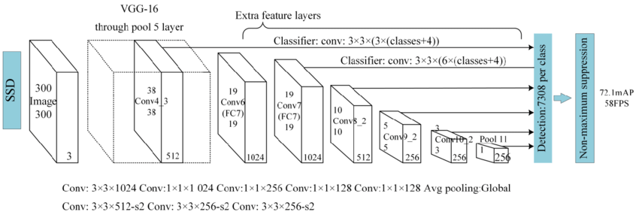
MobileNet SSD Architecture

Slide 8
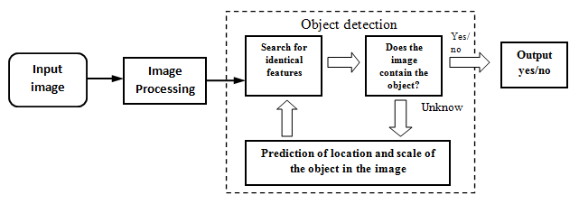
Flow Diagram

Slide 9
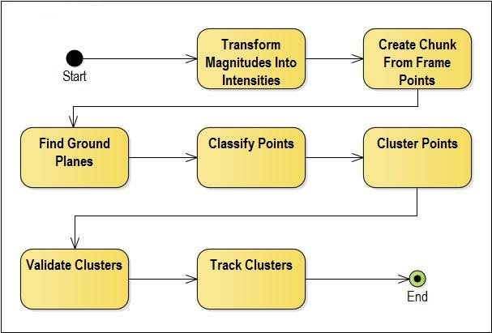
Activity Diagram

Slide 10
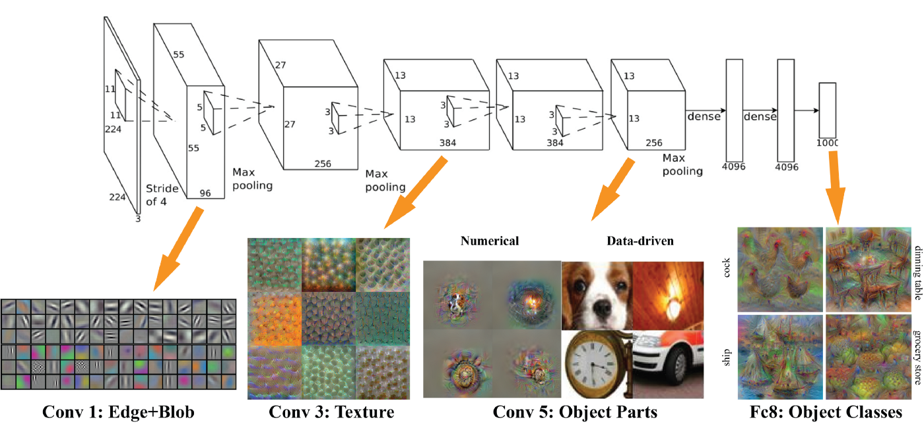
VGG Feature Map Visualisation

Slide 11
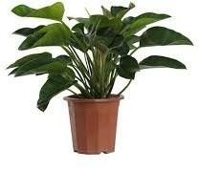
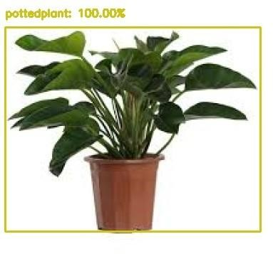
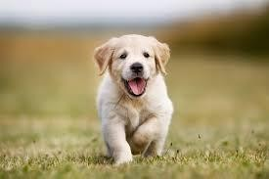
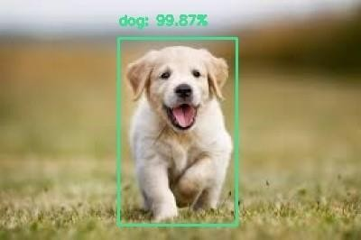

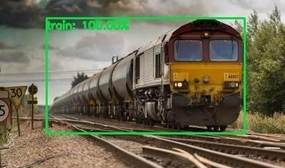
Output

Slide 12
CONCLUSION:
Deep learning based object detection has been a research hotspot in recent years.
Three common tasks, namely object detection, face detection and pedestrian detection, can be accomplished.
Authors accomplished this by combing two things: Object detection with deep learning and OpenCV and Efficient, threaded video streams with OpenCV.
The camera sensor noise and lightening condition can change the result as it can create problem in recognizing the object. The end result is a deep learning- based object detector that can process around 6-8 FPS

Slide 13
References
Bruckner, Daniel. Ml-o-scope: a diagnostic visualization system for deep machine learning pipelines. No. UCB/EECS-2014-99.CALIFORNIA UNIV BERKELEY DEPT OF ELECTRICAL ENGINEERING AND COMPUTER SCIENCES, 2014.
K Saleh, Imad, Mehdi Ammi, and Samuel Szoniecky, eds. Challenges of the Internet of Things: Technique, Use, Ethics. John Wiley & Sons, 2018.
Petrov, Yordan. Improving object detection by exploiting semantic relations between objects.MS thesis.UniversitatPolitècnica de Catalunya, 2017.
Nikouei, SeyedYahya, et al. "Intelligent Surveillance as an Edge Network Service: from Harr-Cascade, SVM to a Lightweight CNN." arXiv preprint arXiv:1805.00331 (2018).

Slide 14
Thanking You...

